Slide 1
Inspection
PowerPoint presentation
Unit 304: Electrical Installations: inspection, testing and commissioning

Slide 2
Inspection
The detailed inspection must include the following (BS7671 Regulation 611.3 - page 197) where relevant:
connection of conductors
identification of conductors
routing of cables in safe zones or protection against mechanical damage, in compliance with Section 522
selection of conductors for current-carrying capacity and voltage drop, in accordance with the design
connection of single-pole devices for protection or switching in line conductors only
correct connection of accessories and equipment
presence of fire barriers, suitable seals and protection against thermal effects

Slide 3
Inspection
methods of protection against electric shock:
(a) both basic protection and fault protection, i.e.:
- SELV
- PELV
- Double insulation
- Reinforced insulation
(b) Basic protection (including measurement of distances, where appropriate), i.e.:
- protection by insulation of live parts
- protection by barriers or an enclosure
- protection by obstacles
- protection by placing out of reach

Slide 4
Inspection
(c) fault protection
(i) automatic disconnection of supply confirmed for presence and sized in accordance with the design:
• earthing conductor
• circuit protective conductors
• protective bonding conductors
• supplementary bonding conductors
• earthing arrangements for combined protective and functional purposes
presence of adequate arrangements for alternative sources(s), where applicable
FELV
choice and setting of protective and monitoring devices (for fault and/or overcurrent protection)

Slide 5
Inspection
(ii) non-conducting location (including measurement of distances, where appropriate)
Absence of protective conductors
(iii) earth-free local equipotential bonding
presence of earth-free protective bonding conductors
(iv) electrical separation.
(d) additional protection

Slide 6
Inspection
(ix) prevention of mutual detrimental influences
(x) presence of appropriate devices for isolation and switching correctly located
(xi) presence of undervoltage protective devices
(xii) labelling of protective devices, switches and terminals
(xiii) selection of equipment and protective measures appropriate to external influences
(xiv) adequacy of access to switchgear and equipment
(xv) presence of danger notices and other warning notices
(xvi) presence of diagrams, instructions and similar information
(xvii) erection method.

Slide 7
Inspection
Use of human senses
Sight: identification of conductors, presence of diagrams and charts, correct size conductors, presence of fire barriers or presence of earthing conductor.
Touch: connection of conductors, containment systems are not sharp causing damage to cables, overheating, barriers and enclosures.
Hearing: This is not a primary sense for initial inspections but when carrying out periodic inspections during the initial walk round, unusual sounds, eg arcing, may indicate problems.
Smell: overheating can often be detected by using the sense of smell.

Slide 8
Special locations
By their very nature special locations, as identified in Part 7 of BS7671, will have specific requirements unique to that location and it is important that you familiarise yourself with them and include them in your inspection.
For example, in Section 701: Locations containing a bath or shower, regulation 701.512.2 ‘External influences’ states:
Installed electrical equipment shall have at least the following degrees of protection:
In zone 0: IPX7
In zone 1 and 2: IPX4

Slide 9
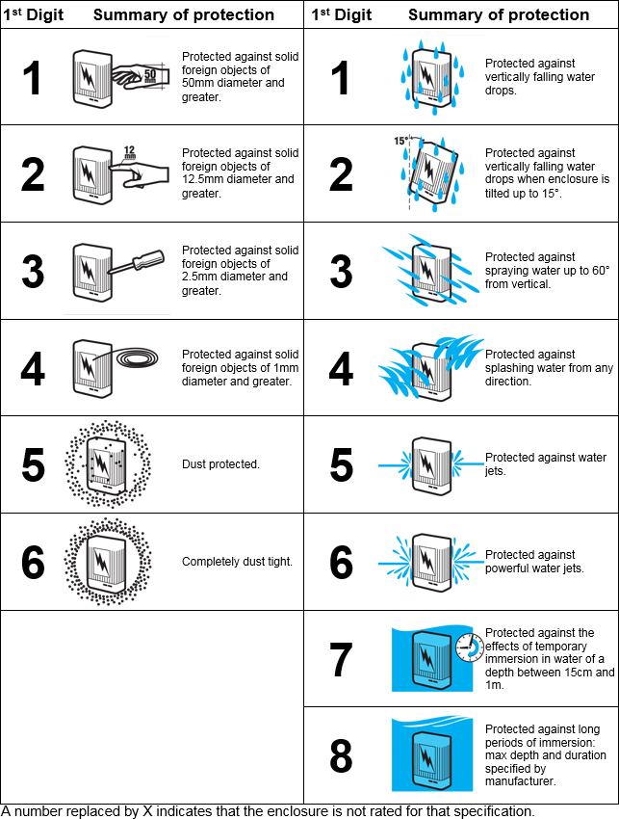
IP (Ingress Protection rating

Slide 10
Any questions?

